Slide 1
Enhancing Educational Outcomes with Data-Driven Insight. A Comprehensive Approach Aligned with SDG 4: Quality Education

Slide 2
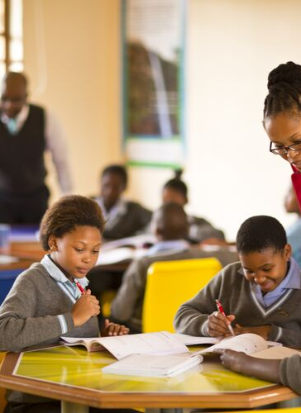
Overview This project aims to improve educational quality and equality. The fourth Social Development Goal highlighted for this project is Quality Education. It aims to ensure inclusive and equitable quality education and promote lifelong learning opportunities for all. The key focus areas are: - Access to basic education - Educational quality - Resource Allocation.

Slide 3
Problem Definition and Significance
There are so many challenges in achieving quality education; such as:
Disparities in access
Insufficient resources
Varying educational outcomes
Inequality
Racial issues within the system.
Addressing issues related to SDG Goal 4 is essential because education is a catalyst for broader social, economic, and personal development. Without a strong focus on ensuring inclusive, equitable, and quality education for all, other development goals would be much harder to achieve. By investing in education, societies can unlock the potential of every individual, drive economic prosperity, and create a more just and sustainable world.

Slide 4
Socio-economic Disparities
Basic Education in South Africa takes place in primary and secondary level from Grade 1 (6 - 7-year-olds) to Grade 12 (18 - 20-year-olds). Students who succeed in the year 12 graduate with a matriculation certificate, which enables them to transition to tertiary level education. Statistics SA revealed a youth unemployment rate of 63.9% for those aged 15-24 in the first quarter of 2022. According to the Department of Basic Education’s statistics for 2018, out of 23,471 public schools, 20,071 have no laboratory. Furthermore, 18,019 have no library, while 16,897 have no internet. Almost 1,000 schools have no sports facilities, while 4,358 have only illegal plain pit latrines for sanitation; 1,027 have no perimeter fencing, essential for teacher and pupil safety, 239 have no electricity, and 37 have no sanitation facilities at all.
Language Barriers
South Africa's diverse linguistic landscape poses another hurdle to effective education. The country has twelve official languages, making it difficult to implement a standardised curriculum across the nation. This language barrier often hinders the acquisition of foundational literacy and numeracy skills, leading to poor academic performance and high dropout rates.

Slide 5
This project will focus on :
The region where the school is based
The school
The number of students and their performance
The Curriculum
The assessment
Resource Allocation
Main Objectives:
Identifying educational disparities
Optimizing resource allocation

Slide 6
This database design and schema provide a robust framework for storing and analyzing educational data, aligning with the goals of improving education quality and equity under SDG 4.

Slide 7
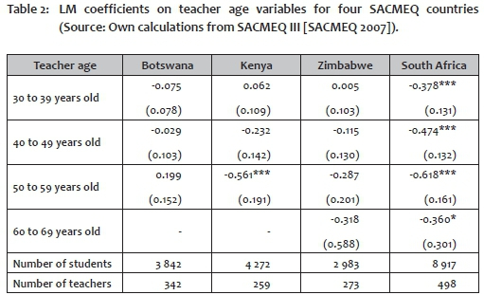
The distribution of resources in education in South Africa, especially between racial groups, has been highly unequal.
Many quantitative researchers reveal strong inequalities in educational outcomes: of 100 children who started Grade 1 in 2007, only 51 made it to matric, 40 of the 2018 matric cohort passed and 17 received bachelor's passes. Only 40% of those who began Grade 1 passed matric.
To ensure that the educational resources are sufficient in the educational system. Making resources such as textbooks, and teaching equipment available in areas where it is deficient

Slide 8
By helping identify gaps in access to education, such as disparities between urban and rural areas or between different socioeconomic groups. By mapping school locations, and analyzing enrolment rates, policymakers can target the most needed interventions.
By monitoring student performance through assessments and evaluations can help provide insights on the quality of education.
To ensure that the educational resources are sufficient in the educational system. Making resources such as textbooks, and teaching equipment available in areas where it is deficient. By gathering information on where the resources are needed, they can then be allocated accordingly. Ensuring that schools have adequate resources is crucial for delivering quality education.

Slide 9
Learning outcomes and Inequality. Analyzing data on learning outcomes across different demographic groups can reveal disparities and help develop targeted strategies to address educational inequalities. This includes examining outcomes by gender, income level, and disability status.
Skills Development: Data on the alignment between educational curricula and labor market needs can help ensure that education systems are preparing students with relevant skills for future employment. This includes tracking employment outcomes for graduates.

Slide 10
In summary, our project addresses the critical challenges in achieving quality education, as outlined in SDG 4. By leveraging a comprehensive database and data-driven insights, we've developed a system that can identify disparities, optimize resource allocation, and ultimately enhance educational outcomes.
The insights derived from our analysis and the tools we've created, such as the Excel dashboard, are not just theoretical. They have the potential to directly influence policy, improve school management, and provide equitable educational opportunities for all students, regardless of their background.
In a world where education is the key to unlocking human potential, our project stands as a vital step towards ensuring that every child has access to quality education. By focusing on data, we can make informed decisions that lead to tangible improvements in educational systems worldwide.

Slide 11
Call To Action
We invite educators, policymakers, and stakeholders to collaborate with us in refining and expanding this project. Together, we can scale these solutions to more regions, ensuring that no child is left behind in our pursuit of quality education.
To turn this vision into reality, we seek your support. Whether through funding, partnerships, or advocacy, your contribution can make a significant difference in helping us achieve our goals.
If you're as passionate about education as we are, we encourage you to take action today. Join us in this mission, explore the data, use the dashboard, and help drive the changes that our educational systems so desperately need.
For those interested in learning more or getting involved, please don’t hesitate to reach out. We’re excited to discuss how we can work together to make a lasting impact.
Mammuso@icloud.com educateprblm@gmail.com
Together, we can ensure that every child has access to the quality education they deserve. Let’s take the next step towards achieving this vital goal of sustainable development. Thank you.

